Slide 1
A Quick Overview of the EU’s
Digital Product Passport (DPP) Initiative
RLA Webinar - April 3, 2024
Avedis H. Seferian
President & CEO

Slide 2
EU policy evolution 2013-2022

Slide 3
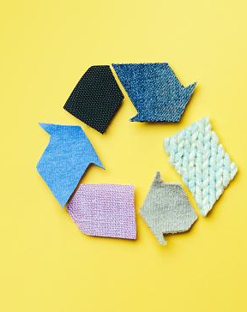
In March 2022, the European Commission adopted a wide-scope Eco-design for Sustainable Product Regulation (ESPR) proposal, including the creation of an EU Digital Product Passport (DPP).
The proposal aims to enhance the circularity and energy performance of products in Europe by setting guidelines and benchmarks on various components.
The Digital Product Passport is a new initiative that is part of the ESPR and one of the key actions under the Circular Economy Action Plan.

Slide 4
ESPR Developments in 2023: The European Council and the European Parliament reached a provisional agreement on the proposed regulations on December 4, 2023. The rollout of these regulations will begin in 2026, and by 2030, the EU will mandate DPP on every product.

Slide 5
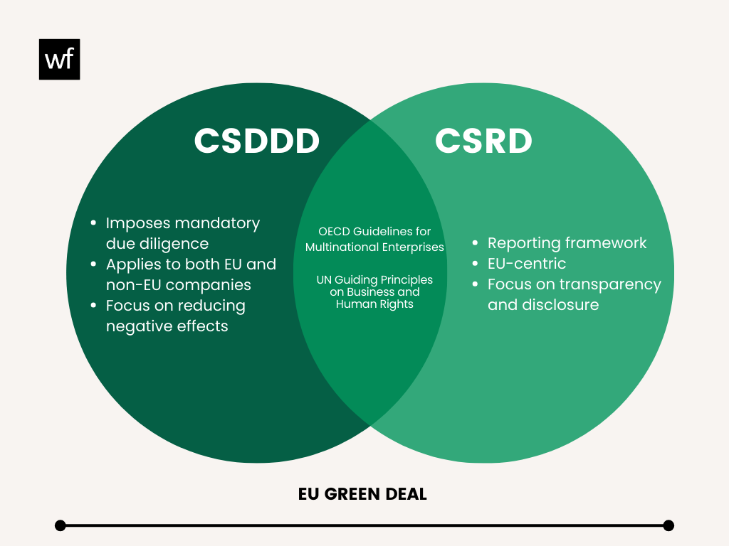
Part of the larger EU Green Deal legislative landscape
CSRD: Corporate Sustainability Reporting Directive
CSDDD: Corporate Sustainability Due Diligence Directive

Slide 6
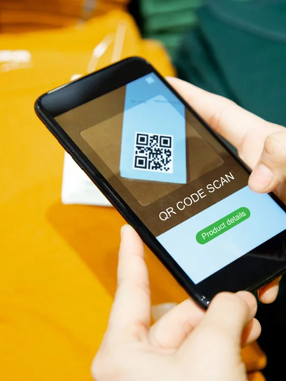
What is a Digital Product Passport?
The DPP refers to a decentralized digital record system that collects and shares product data throughout its entire lifecycle. It contains vital information about a product’s origin, manufacturing process, materials used, and environmental impact.
Through a data carrier (QR code, RFID, etc.), consumers can gain access to important details such as the types of materials used, the product’s carbon footprint, repair instructions, recycling guidelines, and manufacturing processes. A product’s digital record must include data sourced across a product’s entire value chain, from manufacturers and importers to repairers and recyclers.

Slide 7
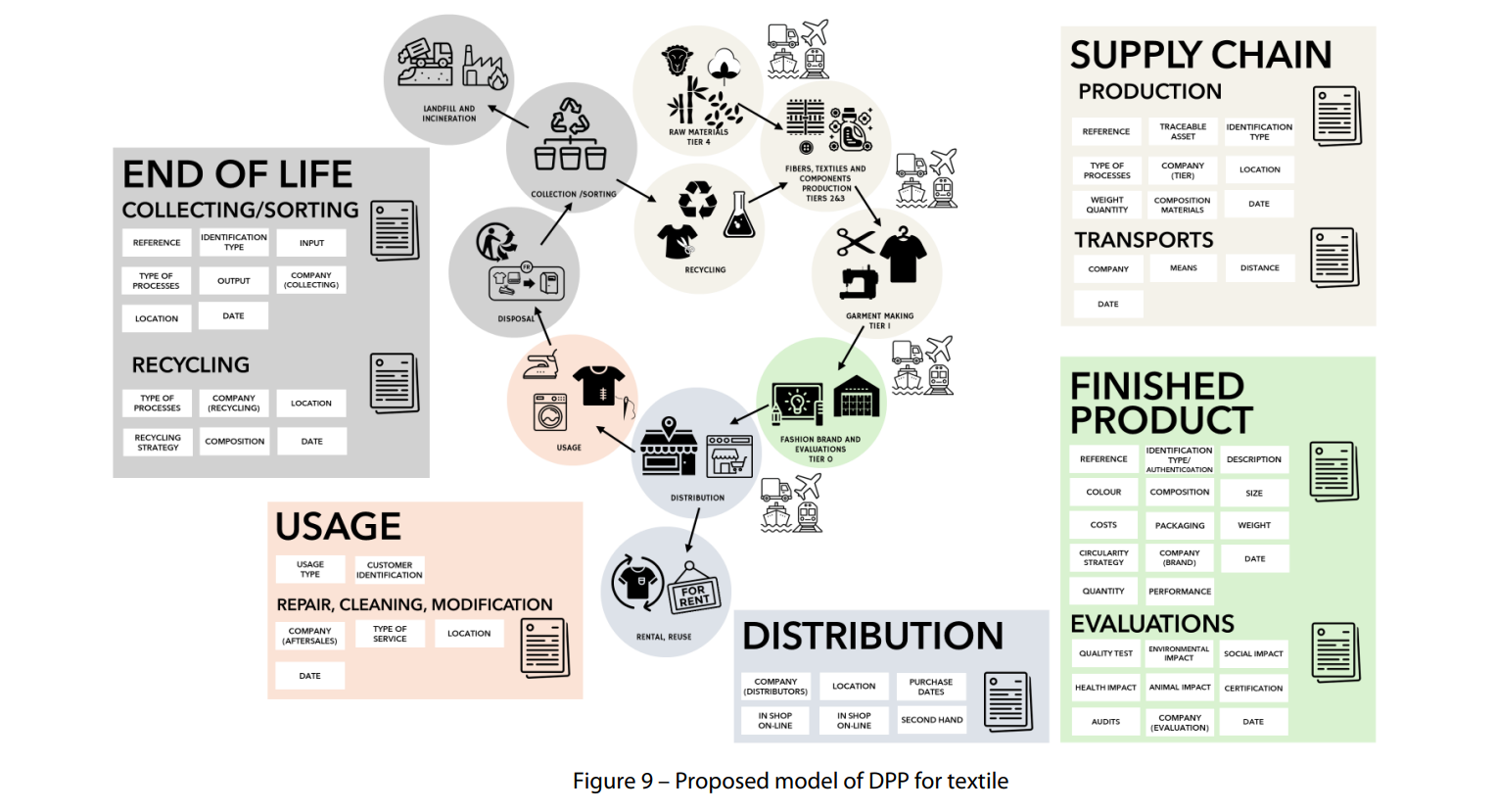

Slide 8
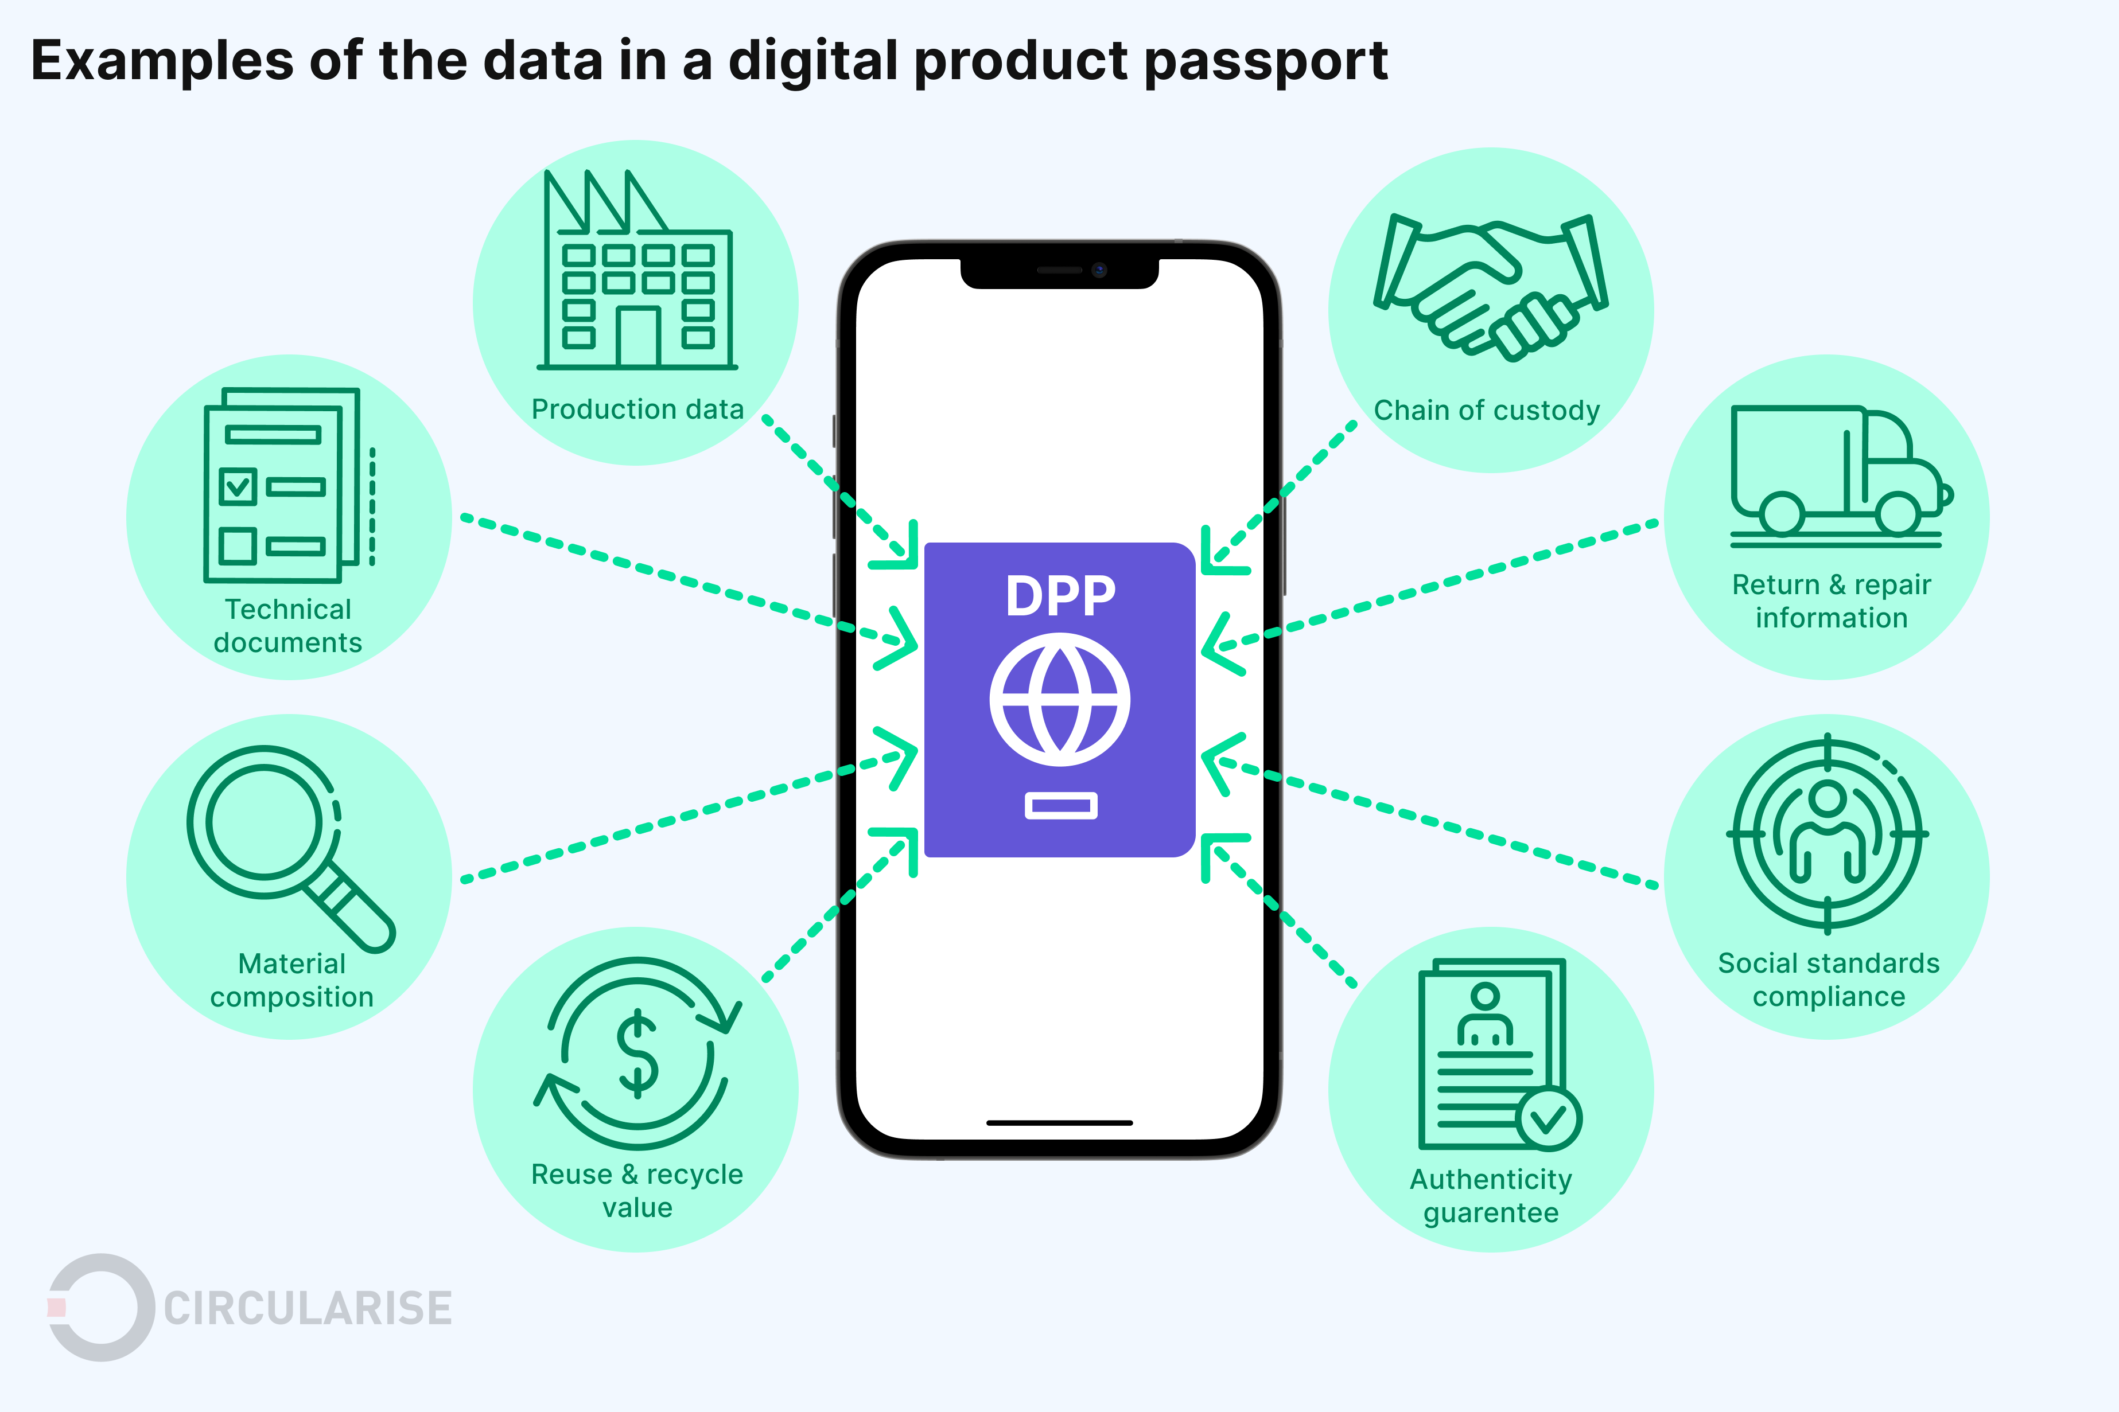
Driving Sustainability Through Innovation
From https://www.circularise.com/blogs/data-in-a-dpp

Slide 9
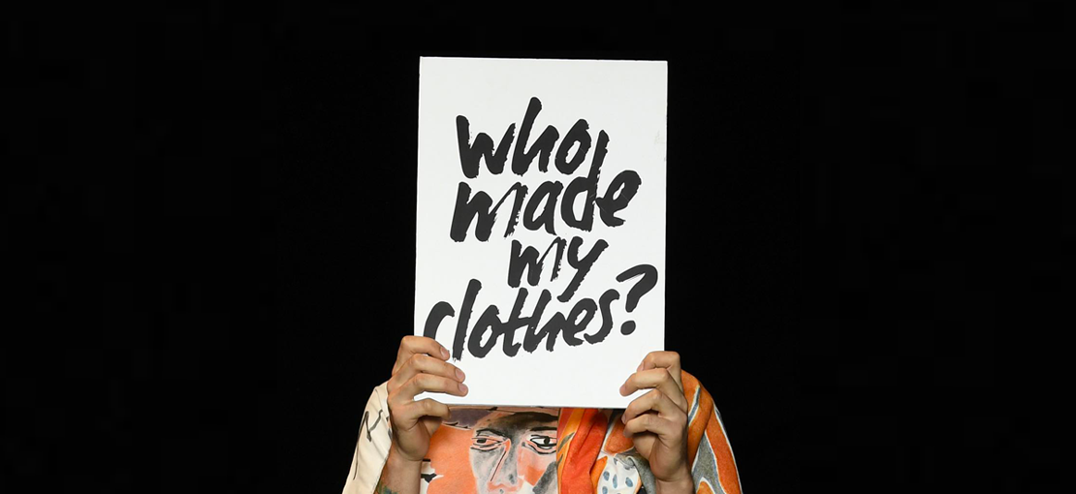
Macro overview of changing consumer/civilian awareness
Environmental Impact
Climate change awareness: Fridays for the Future, Greta Thunberg>>increase in news coverage of major weather events and increasing temps, climate reporters
>>More conversations about resource depletion
Social Impact
Labor Conditions: Fashion Revolution, Remake, Garment Workers Center in LA, Human Rights Watch
>>Consumers are calling for greater transparency to trace the origins of products and ensure that they are ethically produced
Consumer Activism
Hashtags like #whomademyclothes and #sustainablefashion encourage consumers to ask questions and demand accountability from brands.
Growing peer pressure for ethical consumption, this includes supporting brands that use eco-friendly materials, pay fair wages, and uphold labor rights.

Slide 10
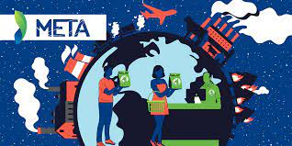
Empowering Consumers & Increasing Awareness and Engagement
Supply Chain Transparency: Visibility into the entire supply chain of a product
Product Origins and Materials: Trace information about whether they are sustainably sourced, organic, recycled, or synthetic.
Environmental Impact: I.e. carbon emissions, water usage, and waste generation.
Social Impact and Labor Practices: Sharing details about labor practices, worker conditions, and fair wages throughout the supply chain.
Certifications and Standards: Digital passports may include certifications and standards that verify a product's sustainability claims.
Consumer Engagement: This transparency helps consumers understand the environmental and social impact of different materials and make choices aligned with their values.

Slide 11
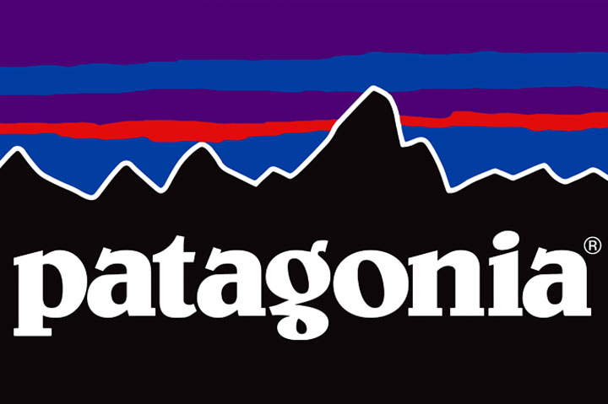
Two case studies
Patagonia
Implementation: "The Footprint Chronicles" allows consumers to trace the environmental and social impacts of each product through the supply chain.
Features: The Footprint Chronicles provide detailed information about the materials used, manufacturing processes, and transportation involved in the production of Patagonia's products. Consumers can access this information online or through mobile apps by scanning QR codes on the product labels (about 150 items)
Impact: The implementation of The Footprint Chronicles has increased transparency and trust among Patagonia's consumers. It has encouraged other apparel brands to adopt similar transparency initiatives.
Start-up EON and Chloe for Vestiaire and resale https://www.eon.xyz/clients/chloe
Implementation: As part of the SS23 collection, Chloé unveiled Chloé Vertical, featuring innovative Digital ID technology. The collection was the first to leverage Instant Resale – introducing a new chapter of transparency for luxury – a first in the industry.
Features: Chloé customers can scan their products and trace their item from field to the finished piece. Customers can scan their product and instantly resell through Vestiaire Collective.
Impact: TBD but inspiring and potentially a great way forward for brand initiatives around circularity.

